Slide 1
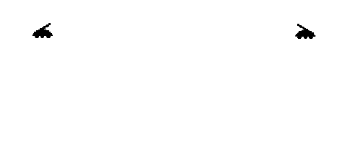
Matthew Scofield, Benjamin Eavenson,
Joseph Van Boxtel, Henry Unruh

Slide 2
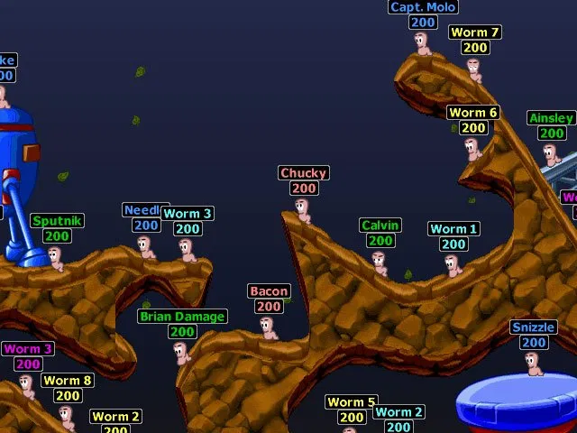
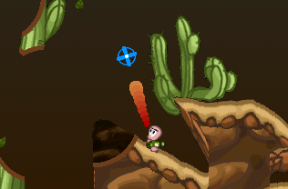
Gameplay Loop
Worms clone with tanks
Players take turns
On their turn they move one of their tanks through the landscape
On their turn they make one attack
Each turn has a time limit
Players can pick up weapons throughout the battlefield by moving into them
Last player with living tanks wins

Slide 3
Complexity
(10) Hotseat Multiplayer
(20) Scrolling World
(30) Gravity
(15) Realtime Elements
(20) Many Weapon Types (Complex Power-Ups)
(20) Destructible Terrain (Rich Behavior)
(10) Explosions, Fire, and other Moderate Art and Animations
Total Points Projection: 125

Slide 4
High-Bar features
Unique Power-Ups
Non Turn-Based Multiplayer
Zoom-able world
Different Classes of Tanks(Heavy, Fast, ect)
Physics Objects

